Slide 1



walmart sales data analysis
View in Power BI
Last data refresh:
12/8/2022 5:52:28 PM UTC
Downloaded at:
12/8/2022 5:57:10 PM UTC

Slide 2
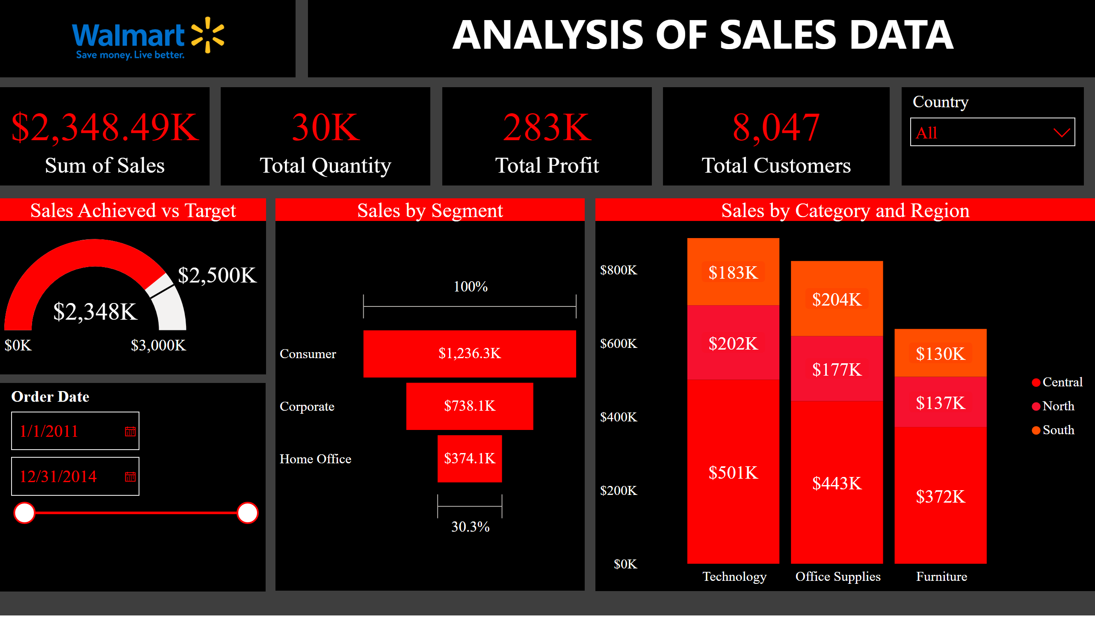
Page 1
Notes:
slicer
No alt text provided
Sales by Category and Region
No alt text provided
Sales by Segment
No alt text provided
slicer
No alt text provided
Sales Achieved vs Target
No alt text provided
card
No alt text provided
card
No alt text provided
card
No alt text provided
textbox
No alt text provided
textbox
No alt text provided
image
No alt text provided
card
No alt text provided

